Slide 1
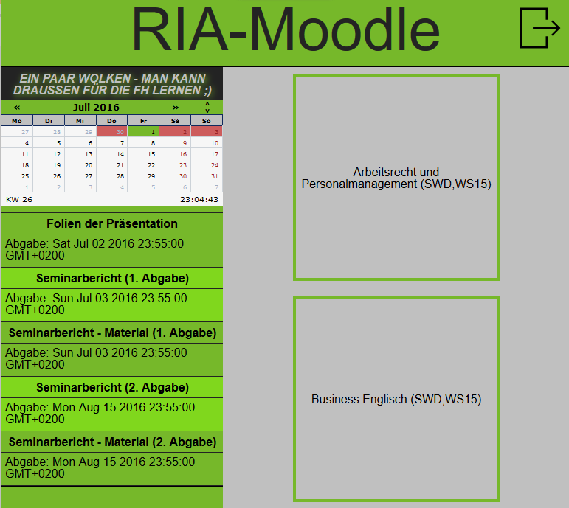




Software Design
SWD14
JS
Markus Schalk
Patrick Kainz
Patrick Papst

